Slide 1
History of internet ISP, Browsers, Web-Links, Search engines, Internet Services – part 2

Slide 2
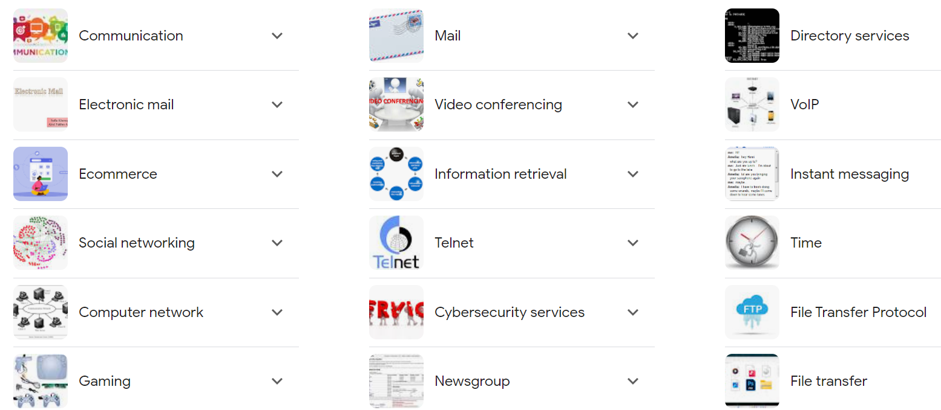
Basic internet services

Slide 3
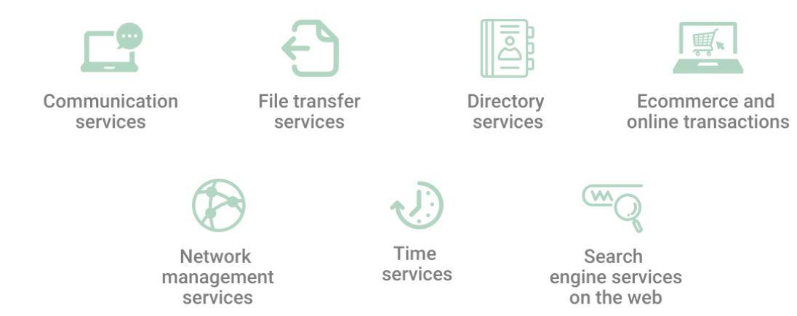
Basic internet services

Slide 4
1. Communication services
To exchange data/information among individuals or organizations, the internet enables communication services.
This mainly includes VoIP and video conferencing.
Other communication services based on the internet include email, internet relay chat (IRC), and list server (LISTSERV) used for asynchronous text communication, instant messaging, and group announcements, respectively.

Slide 5
2. File transfer services
We utilize file transfer to exchange, transmit, or send a document or logical data item among many individuals or computers, both locally and remotely.
Data files may comprise documents, videos, photos, text, or PDFs.
They may be shared via internet downloading and uploading.
File transfer protocol (FTP) is one of the most common internet protocols used for this purpose.

Slide 6
3. Directory services
A directory service is a collection of software that maintains information about the organization, its customers, or both.
Directory services are responsible for mapping network resource names to network addresses.
It offers administrators and users transparent access to all network computers, printers, servers, and other devices.
It is also an important backend service provider for and by the internet.
Domain number system (DNS) and lightweight directory access protocol (LDAP) are the most commonly used directory services.
A DNS server stores a map of computer hostnames and other domain names to IP addresses.
LDAP is a collection of open protocols to obtain centralized network access to stored data. It is also a mechanism for cross-platform authentication.

Slide 7
4. Ecommerce and online transactions
Ecommerce allows the customer to purchase a service or product directly from the vendor, at any time or anywhere on the planet.
When IBM started offering hardware and software for computers over the internet, it was one of the first instances of ecommerce. Since then, this service has grown in use tremendously.
Ecommerce uses the web to enable financial exchanges so that data packets can translate into their real-world monetary equivalents.

Slide 8
5. Services for network management
Network management services are some of the most critical and valuable internet services for IT administrators.
They assist in avoiding, monitoring, diagnosing, and resolving network-related issues.
Two services are mainly used for this purpose – ping and traceroute.
The ping utility checks the host machine’s availability and the time required to react to any and all internet control message protocol (ICMP) transmissions.
It guarantees that all requests issued by a computer reach the web server without packet loss.
In the meantime, the traceroute identifies and displays all potential paths from query to response, as well as the turnaround time for each route.

Slide 9
6. Time services
Greenwich Mean Time (GMT) or Coordinated Universal Time synchronizes computer clocks (UTC).
Network time protocol (NTP) is an established internet time service that syncs and adjusts the computer clock accurately to all these standards.
All Windows time variants released after Windows 2000 synchronize with an NTP server.
NTPsec is primarily a secured version of NTP.

Slide 10
7. Search engine services on the web
When users search for a web page through a search engine rather than the domain name, the search engine examines the web crawler’s index of all pages.
It will study the search phrase and compare it to the database, including how often the search terms appear on a webpage, where they appear on the site, whether they appear together, etc. It analyzes this information to determine which websites best fit your search query.
The results are then shown in order, with those that best fit the search keyword appearing initially.
It is important to note that search engines can accept funds from commercial entities to prioritize their websites in the results of a particular query. This is an advert, and the search engine results will be labeled as such.

Slide 11
Repeat of internet services …from other source

Slide 12
Communication Services
These for exchanging data or information among individuals or companies.
IRC: is an abbreviated term for Internet Relay Chat, and through this, the users or subscribers of the internet can communicate with the desirable individual in real-time by connecting multiple computers in public spaces named channels.
VoIP: defines the Voice over Internet Protocol that describes the procedure associated with ‘how to connect phone call and receive phone calls over the internet. Many internet users pretend that VoIP is a viable alternative to traditional lines, but this is technically a technique that helps users make audio calls through the internet instead of traditional phone lines (analogue). Users with a proper internet connection can easily reach any individual or group without local phone services. This is because VoIP solutions are totally based on open standards and thus, can be used on the computer device.
User Network: this is termed USENET, works to host the newsgroup along with the message boards over specified topics, and the volunteers mostly execute it.
Telnet: is utilized for connecting a remote computer having an internet connection.

Slide 13
Communication Services
List Server: the list servers or LISTSER are beneficial in delivering a group of emails known as content-specified emails to the recipients.
Email: utilized for delivering electronic emails through the internet and is also considered as the paperless method adopted for delivering text, images, documents, videos, and so on to another individual.
Video Conferencing is a system allowing two or more individuals to connect live and visually by sitting at different locations.
Live Video Conferencing intellectually stimulates face-to-face talks over the internet. Live Video Conferencing helps two people sitting at two different locations to connect using the video-enabled devices and through streaming voice, video, text, and many more in real-time over the internet. This is the service of the internet that ensures that humans can connect and collaborate face to face irrespective of the distance between them.
Hence, for fulfilling the human requirement of video conferencing, several applications or tools, including Zoom, Skype, Google Hangouts, Free Conference, and much more, are available over the internet.

Slide 14
Information Retrieval Services
Information Retrieval Services is defined as the procedure for attaining access to the information or data stored over the internet.
The process associated with attaining, obtaining, or discovering information through the internet is defined as Net surfing.
Connecting the computer with the internet allows humans to initiate the retrieving of data. To attain this data, humans require software known as web browsers.
When users utilize a print or computer-based information retrieval system, they locate and search the data through files, databases, and so on collections of data. Some of the beneficial sites are as follows:
Geeksforgeeks.org: a website having all the data-related materials like free tutorials, articles, live, online, classroom courses, frequent coding-based competitions, industrial-based expert webinars, internships, along with job responsibilities.
Cryola.com: a website known for having advice for students, parents, and educators associated with how to be more creative.

Slide 15
Transferring the files or file transfer
File transfer or transferring of files is the procedure of exchanging data files across computer-based systems.
In other words, file transfer is considered as the transferring and shifting the files in any form, like documents, multimedia, pictures, text, PDFs, and so on, from one device to another through the internet and computer network.
Also, for sharing, transferring, and sending a file or data to multiple servers or machines locally or remotely, humans consider the internet service for file transfer. Hence for making the process of information retrieval through the Internet, the following services can be adopted:
Gopher: a valuable application beneficial for completing the process of file retrieval based on hierarchical and distributed menus. This is highly recommended for file transfer as its interface is easy to use.
FTP: is an abbreviated form of File Transfer Protocol needed for sharing, transferring, and sending files or data across multiple servers or machines, either locally or remotely.
Archie: a directory information retrieval system having a connection linking to the FTP.

Slide 16
World Wide Web
The internet is known for having a wide range of networks of computers interconnected through wireless connections.
Using this Network of computers, humans may simply connect to the World Wide Web, commonly known as www Web.
This www web is regarded as a collection of web pages.
For accessing this www web, the users may adopt web browsers using an internet connection.

Slide 17
Directory Services
Directory Services are considered the set of software beneficial for keeping track of the information related to the company, customers, etc.
A directory service is adopted to offer fully transparent access to the printers, dedicated servers, and so on devices added to the system’s network. Some of the favourable directory services include the following:
DNS: DNS refers to an abbreviated term of Domain Number System providing DNS utilized for mapping computer hostnames with the types of domain names to IP addresses stored on the DNS server.
LDAP: Lightweight Directory Access Protocol, a set of open protocols required to obtain access to the data stored over the central internet. This directory server also functions to interact with other directory servers.

Slide 18
Automatic Network Address Configuration
Automatic Network Address configuration functions to decide the unique IP address to the system added in a network.
In addition, DHCP is another server-based network that assigns IP addresses, gateways, and such network information to the clients’ devices by utilizing the Dynamic Host configuration protocol, a protocol utilized for replying to and broadcasting the inquiries from clients.

Slide 19
Network Management Services
Network Management Services is another important and essential service of the internet needed for network administrators. These network management services somehow intellectually work as an aid in preventing, analyzing, diagnosing, and resolving connection-based issues. The two favourable associated with these basic services provided by the internet are as follows:
Ping: a command prompt command utilized to detect whether the source is beneficial and suitable for communicating with a specified destination. And this ping command is also helpful in getting the possible paths between the devices as well as.
Traceroute: another important command utilized to detect the path between the two connected networks.

Slide 20
Time Services
Using the internet and the operating system facilities, it becomes quite easier for the users to set the clock of their computer device. Some of the services included in the time services are as follows:
NTP: NTP is an abbreviated term for Network Time Protocol used as internet time services allowing the users to synchronize and adjust the clock of their device correctly.
SNTP: SNTP stands for Simple Network Time Protocol: used as a time-keeping protocol functioning to synchronize the network hardware. This protocol is also known as the simplified form of NTP used in the scenario where the full implementation associated with the NTP is not required, but the simplified form of NTP does work.

Slide 21
Usenet and news group
Usenet is also termed aUUser’s Network, a network having an association with online discussion groups. Usenet is the first beneficial Network adopted for uploading files to news-based servers so that humans may clearly view that.
News Group is a lively Online Discussion Forum accessible using the Usenet services of the internet. Each group is likely to have conversations over highlighted topics identified by the group’s name. For reading these newsgroups, the users may adopt the newsreader software for browsing, following, or adding comments over the group.
These newsgroups may also have debates, speeches, or such things related to some revolving topic being posted over the central internet site and distributed over Usenet, known as the global Network of discussion groups associated with popular news. These groups also utilize the NNTP, i.e., Network News Transfer Protocol.

Slide 22
E-commerce
E-commerce is an abbreviated form of Electronic commerce referring to a business concept that ensures that humans, users, and businesses can buy and sell goods using the internet, just like Amazon, Flipkart, and other such websites or mobile marketing services.

Slide 23
Cloud services
Cloud services provide many ways for business team members to interact with the technology they need.
The cloud is an internet-connected platform that can store and access information and programs.
Since the cloud stores the information instead of holding it on a computer, team members can access and use it whether at home or in the office.
Some cloud services can even run operation systems remotely, allowing team members to use internal business programs remotely without installing them on their computers.
Backup solutions: Backup solutions protect information loss from occurring by storing copies of data on external hardware or online platforms, such as a cloud service.

Slide 24
Remote access
What is remote access? Remote access is the ability for an authorized person to access a computer or network from a geographical distance through a network connection.
Remote access enables users to connect to the systems they need when they are physically far away.
Remote access enables remote users to access files and other system resources on any devices or servers that are connected to the network at any time.
Technical support professionals can use remote access to connect to users' computers from remote locations to help them resolve issues with their systems or software.
One common method of providing remote access is via a remote access virtual private network (VPN) connection. A VPN creates a safe and encrypted connection over a less secure network, such as the internet. VPN technology was developed to enable remote users and branch offices to securely log into corporate applications and other resources.

Slide 25
Remote access
Two use cases for remote access software:
1. IT support: Using a computer to connect to an end user’s (employee or customer) device in order to provide remote IT management and support. Streamlined IT troubleshooting and support
2. Personal use: Using a PC in your home office to connect to your office computer or company network. You wouldn't need to travel to your company’s office in order to access company resources. Enhanced flexibility and productivity for businesses and employees; Improved access to business resources from anywhere with greater security; Facilitating remote work and telecommuting
Whether they’re working from home under a remote or hybrid work arrangement or traveling for business, employees must have the ability to access work systems to get work done remotely. Without remote desktop access, they’d only be able to work by showing up in the physical office, which may have been okay in 1998 but isn’t any longer in today’s more flexible, mobile business climate.

Slide 26
Remote access software
Do Try;
Chrome Remote Desktop
AnyDesk
TeamViewer
Splashshot
LogMeIn Pro

Slide 27
What are some common methods of remote access?
There are three typically used types of remote access:
Direct remote access is the most common method: A computer or device connects directly to another computer or device via the internet.
Indirect remote access, as its name implies, involves an intermediary server, which could be a web-based email service, sitting in the middle of two devices and relaying messages between them.
Remote Access VPNs (virtual private networks) create an encrypted connection over the internet, allowing a device to join a private network securely. A VPN for remote access enables remote users to access resources on that network as if they were directly connected to it.

Slide 28
Remote access VPNs
Remote access VPNs connect individual users to private networks.
With a remote access VPN, each user needs a VPN client capable of connecting to the private network's VPN server.
When a user is connected to the network via a VPN client, the software encrypts the traffic before it delivers it over the internet. The VPN server, or gateway, is located at the edge of the targeted network and decrypts the data and sends it to the appropriate host inside the private network.
A computer must have software that enables it to connect and communicate with a system or resource hosted by the organization's remote access service.
Once a user's computer is connected to the remote host, it can display a window with the target computer's desktop.

Slide 29
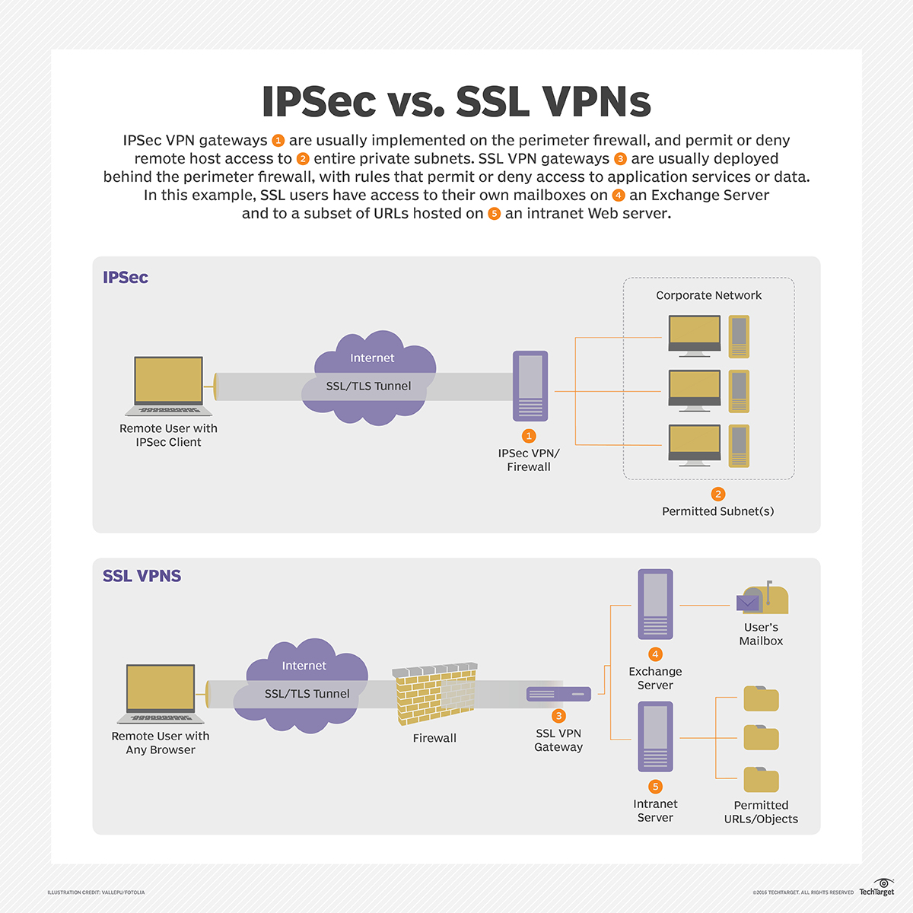

Slide 30
Learn more on remote access
What is Remote Access?
A complete guide to remote access technology, benefits, and security
https://www.goto.com/resources/what-is-remote-access-guide

Slide 31
What are the basic elements of an information system?
There are a wide variety of information systems that companies use to manage and streamline their operations.
Although these systems are diverse, most of them consist of several primary components. Here are the basic elements of most information systems:
Hardware: Hardware refers to all the physical components of an information system that allow people to access data and communicate. These could include desktop computers, smartphones, routers, printers, flash drives and modems.
Software: Software applications are the scripts that hardware systems use to complete various tasks.
Processes: Process refers to a wide range of practices that companies implement regarding their information systems.
Network communications: Networks allow communication between every component in an information system.
Data: Data is a broad category that refers to all the information stored in an information system.
Personnel: This refers to the individual people who access and maintain the information system on a daily basis.

Slide 32
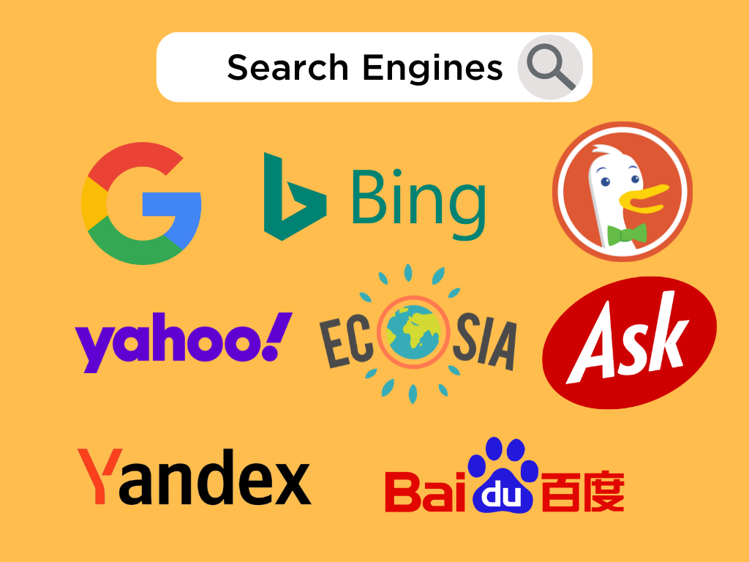
Search engine

Slide 33
Search engine
A search engine is a software program that helps people find the information they are looking for online using keywords or phrases.
Search engines are able to return results quickly—even with millions of websites online—by scanning the Internet continuously and indexing every page they find.
When a user enters a search term, the search engine looks at the website page titles, contents and keywords it has indexed and uses algorithms (step-by-step operations) to produce a list of sites—with the most relevant websites at the top of the list.
Companies use search engine optimization (SEO) to help search engines recognize their websites as highly relevant to particular searches. Popular search engines include Google, Bing and Yahoo.

Slide 34
Search engine
A search engine is a software system that allows users to search for information on the World Wide Web. By scanning and indexing information on literally billions of websites, the search engine is able to present relevant pages to the user when they submit a search query. The results (which are known as the search engine results pages or SERPS) are listed according to how relevant or useful the search engine determines the particular page to be.
Search Engines can be used to find pages, images, videos, business addresses, and other kinds of information. They find this information and rank the pages they feel are relevant according to complex algorithms that are tweaked and improved regularly.

Slide 35
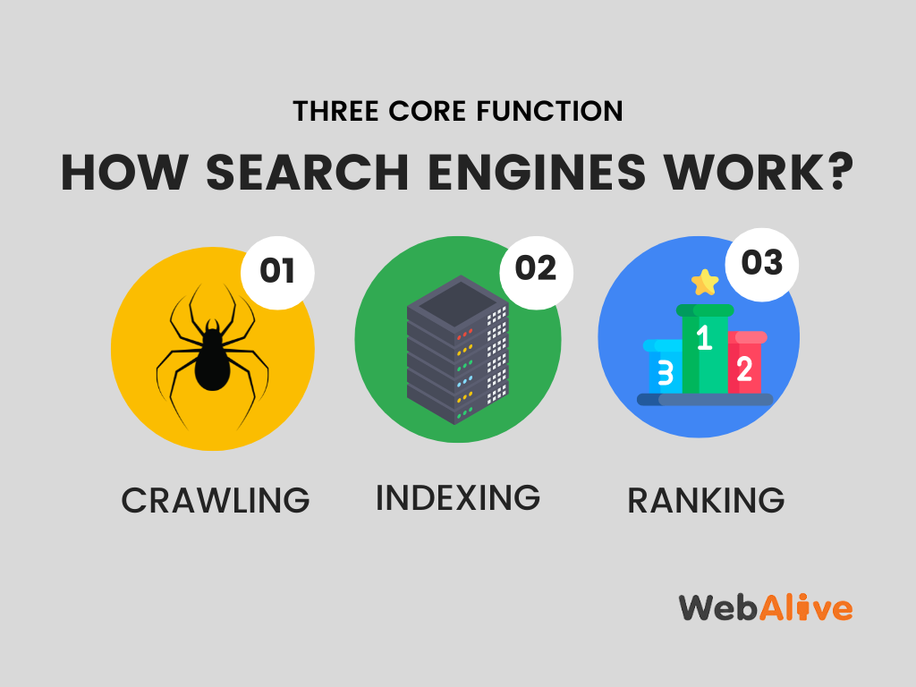

Slide 36
How do search engines work?
Search engines work through three primary functions:
Crawling: Scour the Internet for content, looking over the code/content for each URL they find.
Indexing: Store and organize the content found during the crawling process. Once a page is in the index, it’s in the running to be displayed as a result to relevant queries.
Ranking: Provide the pieces of content that will best answer a searcher's query, which means that results are ordered by most relevant to least relevant.

Slide 37
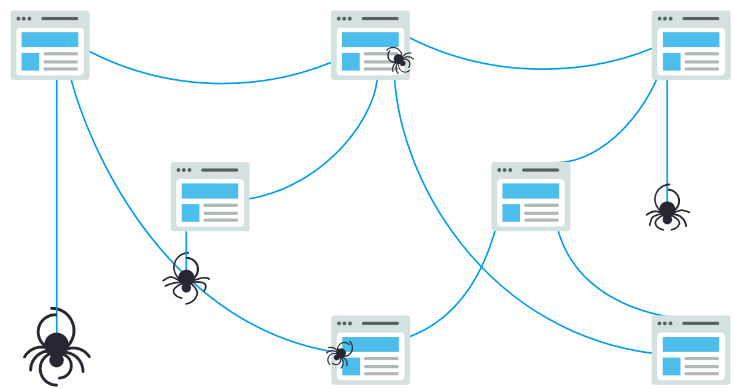
What is search engine crawling?
Crawling is the discovery process in which search engines send out a team of robots (known as crawlers or spiders) to find new and updated content.
Content can vary — it could be a webpage, an image, a video, a PDF, etc. — but regardless of the format, content is discovered by links.
Googlebot starts out by fetching a few web pages, and then follows the links on those webpages to find new URLs. By hopping along this path of links, the crawler is able to find new content and add it to their index called Caffeine — a massive database of discovered URLs — to later be retrieved when a searcher is seeking information that the content on that URL is a good match for.

Slide 38
The search engine index
Webpages that have been discovered by the search engine are added into a data structure called an index.
The index includes all the discovered URLs along with a number of relevant key signals about the contents of each URL such as:
The keywords discovered within the page’s content – what topics does the page cover?
The type of content that is being crawled (using microdata called Schema) – what is included on the page?
The freshness of the page – how recently was it updated?
The previous user engagement of the page and/or domain – how do people interact with the page?

Slide 39
Search engine ranking
When someone performs a search, search engines scour their index for highly relevant content and then orders that content in the hopes of solving the searcher's query. This ordering of search results by relevance is known as ranking. In general, you can assume that the higher a website is ranked, the more relevant the search engine believes that site is to the query.

Slide 40
What happens when a search is performed?
When a search query is entered into a search engine by a user, all of the pages which are deemed to be relevant are identified from the index and an algorithm is used to hierarchically rank the relevant pages into a set of results.
The algorithms used to rank the most relevant results differ for each search engine. For example, a page that ranks highly for a search query in Google may not rank highly for the same query in Bing.
In addition to the search query, search engines use other relevant data to return results, including:
Location – Some search queries are location-dependent e.g. ‘cafes near me’ or ‘movie times’.
Language detected – Search engines will return results in the language of the user, if it can be detected.
Previous search history – Search engines will return different results for a query dependent on what user has previously searched for.
Device – A different set of results may be returned based on the device from which the query was made.

Slide 41
Three functions
Crawling
Search engines use programs, called spiders, bots or crawlers, to scour the internet. They may do this every few days, so it is possible for content to be out-of-date until they crawl your website again.
Indexing
The search engine will try to understand and categorise the content on a web page through 'keywords'. Following SEO best practice will help the search engine understand your content so you can rank for the right search queries.
Ranking
Search results are ranked based on a number of factors. These may include keyword density, speed and links. The search engine's aim is to provide the user with the most relevant result.
Although most search engines will provide tips on how to improve your page ranking, the exact algorithms used are well guarded and change frequently to avoid misuse. But by following search engine optimisation (SEO) best practice you can ensure that:
Search engines can easily crawl your website. You can also prompt them to crawl new content.
Your content is indexed for the right keywords so it can appear for relevant searches.
Your content can rank highly on the SERP.

Slide 42
Search engine optimisation (SEO)
In order to show up in search results, your content needs to first be visible to search engines. It's arguably the most important piece of the SEO puzzle: If your site can't be found, there's no way you'll ever show up in the SERPs (Search Engine Results Page).

Slide 43
Search engine optimisation friendly web design
Some of the best search engine optimisation (SEO) results can be achieved by optimising site design and content to according to the factors used by search engines to index web pages. Good site design makes it easier for search engines to index your site, and increases your chances of a higher ranking in the results pages. Basic SEO techniques include:
site accessibility
high quality content
links to and from other websites
use of relevant keywords
Make your site accessible
The most important part of making a website search-engine friendly is good design. A well designed website that will get repeat visitors as well as satisfied customers will include:
well-written, interesting content
easy-to-navigate pages
well-designed e-commerce systems

Slide 44
Google alternative search engines
65% of the world uses Google
Bing Microsoft’s search engine is the second most popular search engine in the world, with 15.8% of the search market.
Why Bing?
Bing’s video search is significantly better than Google’s, giving you a grid of large thumbnails that you can click on to play or preview if you hover over them.
Bing often gives twice as many autocomplete suggestions than Google does.
Bing can predict when airfares are about to go up or down if you’re searching for flights.
Bing also has a feature where if you type linkfromdomain:[site name] it will highlight the best ranked outgoing links from that site, helping you figure out which other sites your chosen site links to the most.

Slide 45
DuckDuckGo
The key feature of DuckDuckGo is that it doesn’t retain its users‘ data, so it won’t track you or manipulate results based on your behaviour. So if you’re particularly spooked by Google’s all-seeing, all-knowing eye, this might be the one for you.

Slide 46
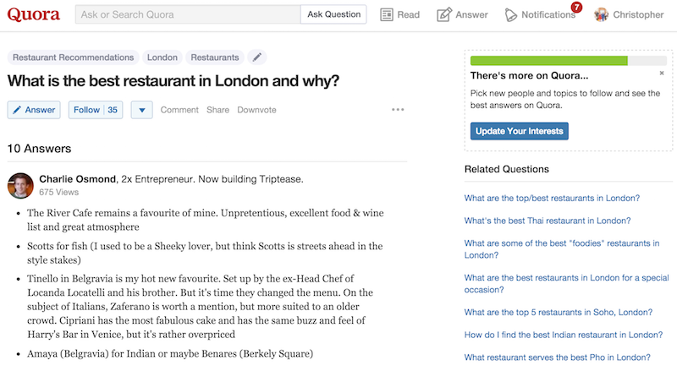
Quora
As Google gets better and better at answering more complicated questions, it will never be able to match the personal touch available with Quora.
Ask any question and its erudite community will offer their replies. Or you can choose from any similar queries previously asked.

Slide 47
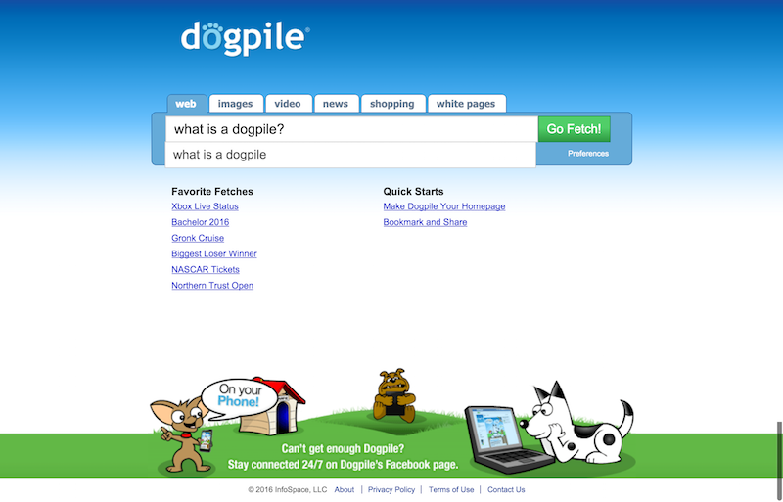
Dogpile
Dogpile may look like a search engine you cobbled together with clip-art, but that’s rather the point as it pulls in and ‘curates’ results from various different engines including Google, Yandex and Yahoo, but removes all the ads.

Slide 48
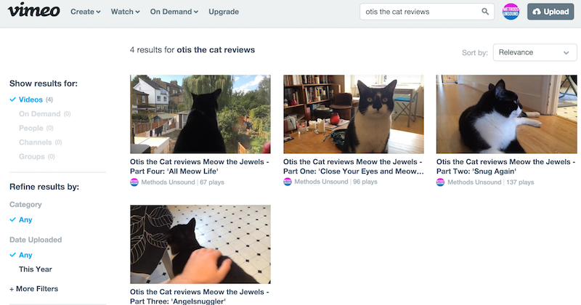
Vimeo
Of course if you’re going to give up Google, then you’ll also have to give up YouTube, which can be a terrifying prospect.
But there is an alternative. And a pretty good one at that… Vimeo.
The professional’s choice of video-sharing site, which has lots of HD video and no ads.

Slide 49
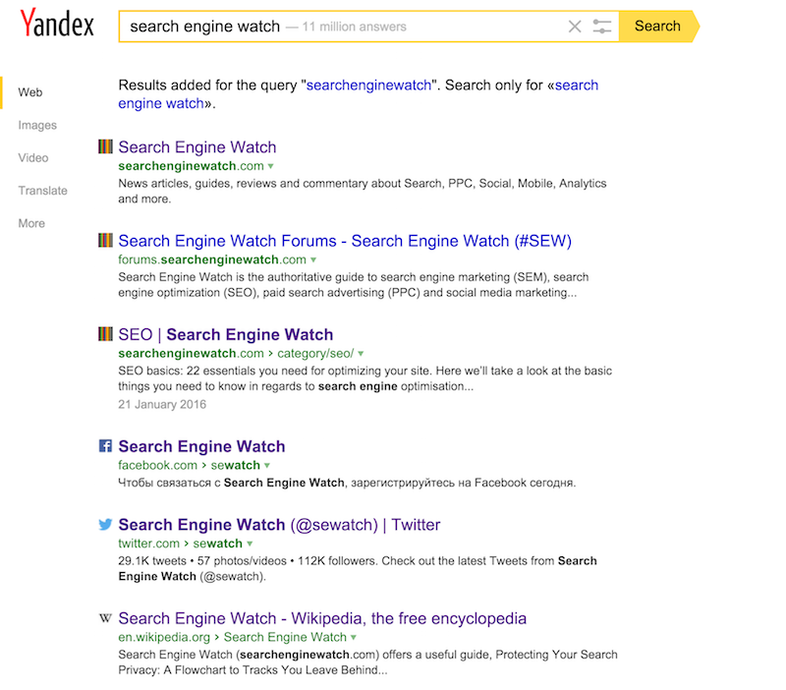
Yandex
This is a Russian portal, offering many similar products and services as Google, and it’s the dominant search engine in Russia.
As you can see it offers results in a nice logical format, replete with favicons so you can clearly see the various channels for your branded queries.

Slide 50
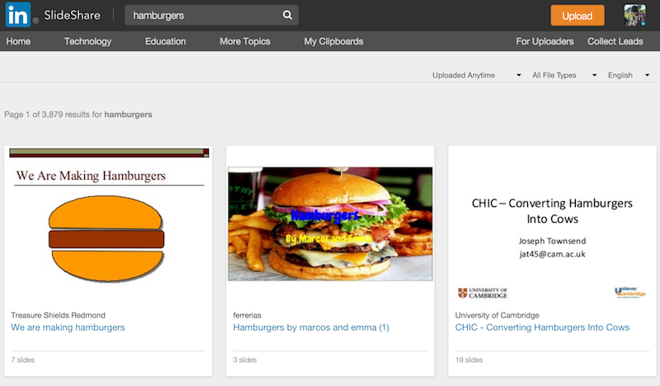
SlideShare
SlideShare is a really handy place to source information from presentations, slide decks, webinars and whatever else you may have missed from not attending a conference.

